Slide 1
Units12&7
2019 SPECIFICATION:
Unit 12: Practical Sports Application
2016 SPECIFICATION:
Unit 7: Practical Sports Performance

Slide 2
Unit aims
You will develop the skills, techniques, tactics and understanding of rules needed to participate in tennis individually or as a pair.
This unit gives you the opportunity to improve your own knowledge and
practical ability in tennis.
You will develop your own practical performance in tennis, focusing on the application of skills, techniques and tactics and reflecting on your performance.
This will be achieved through participation in practical activities, followed by a reflection on your performance. You will have the opportunity to practise and refine your individual skills and techniques, investigating and experiencing different areas of tactics and techniques.
The rules and regulations of tennis will also be investigated, since an
awareness of the rules can often lead to an improvement in performance.

Slide 3
Learning aims
2019 Specification
Explore skills, techniques and tactics required in selected sports
Use skills, techniques and tactics in an individual and a team sport
Review own and other individuals’ performance in an individual and a team sport to inform future development
2016 Specification
Examine national governing body rules / laws and regulations for selected sports competitions
Examine the skills, techniques and tactics required to perform in selected sports
Develop skills, techniques and tactics for sporting activity in order to meet sport aims
Reflect on own practical performance
using selected assessment methods
Notes:
All 2019 Learning Aims are identified on slides in light blue text
All 2016 Learning Aims are identified on slides in green text

Slide 4
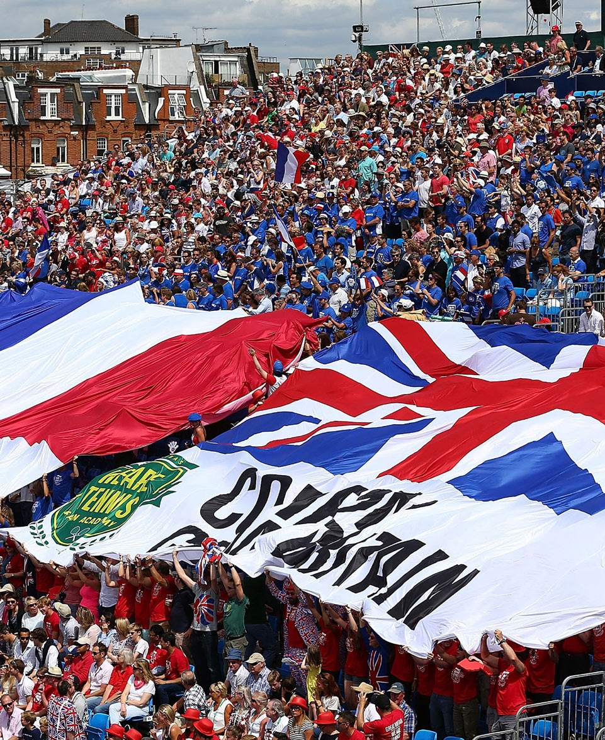
A4: Individual sports
A1: NGB rules AND laws in TENNIS
The National Governing Body (NGB) for tennis is the Lawn Tennis Association (LTA), recognised by UK Sport and the International Olympic Committee (IOC).
Tennis rules / laws are regulated by the LTA and the International Tennis Federation (ITF), which is the international governing
body for tennis.
Notes:
2019: A4 Individual sports
And
2016: A1 NGB rules/laws in selected sports

Slide 5
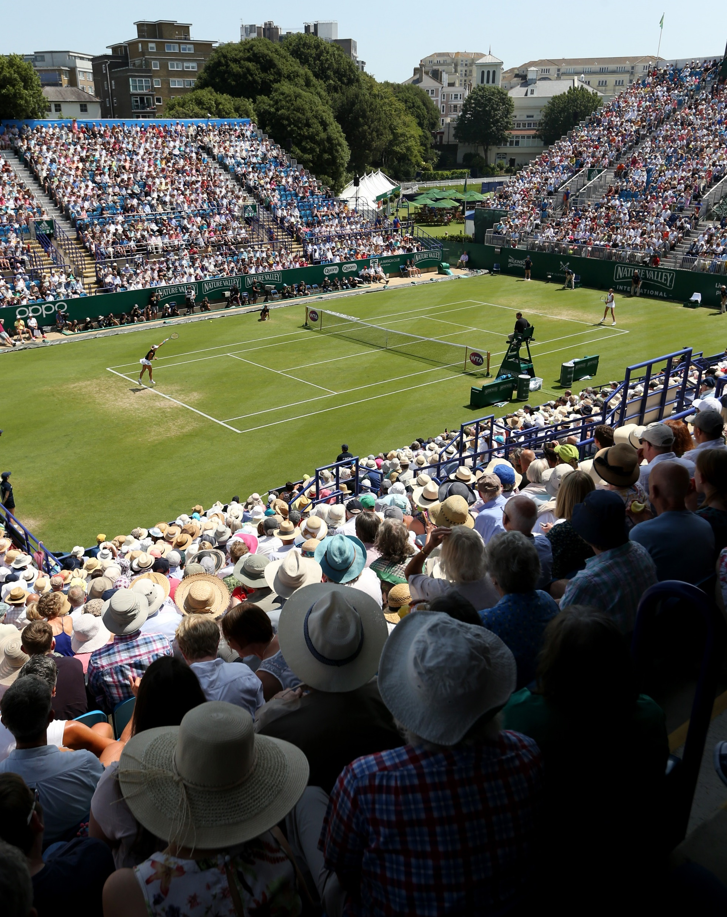
A4: Individual sports
A1: NGB rules AND laws in TENNIS
Rules and Regulations in Tennis
Regulations for sports under competition rules:
Regulations for players and participants
Equipment
Playing surface / area
Health and safety
Facilities
Scoring system
Spectators
Notes:
2019: A4 Individual sports
And
2016: A1 NGB rules/laws in selected sports

Slide 6
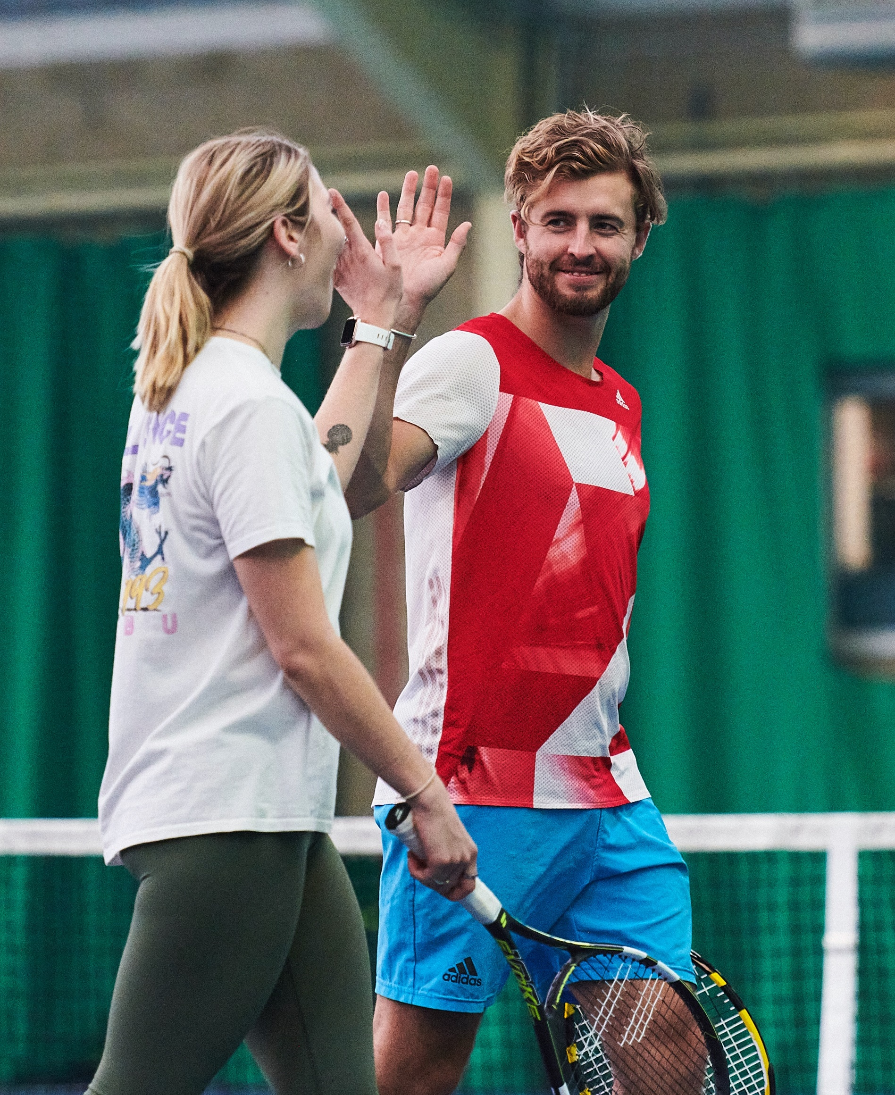
A4: Individual sports
A1: NGB rules AND laws in TENNIS
Unwritten rules and etiquette in tennis
Unwritten rules aim to maintain the welfare behaviour
of competitors, sportsmanship and ethics.
Unwritten rules are used in situations where rules / laws have been applied both legally and illegally, for example, gaining an unfair advantage to win in a competitive environment.
Notes:
2019: A4 Individual sports
And
2016: A1 NGB rules/laws in selected sports

Slide 7
A2: roles and responsibilities
of officials
Key officials in tennis:
Umpires
Line judges
Tournament
referees
Responsibilities of
the officials in tennis competitions:
Interpretation and application of the
rules / laws
Control of competitors
Health and safety
Use of technology
Effective communication
Fitness requirements
Qualifications
Notes:
2016: A2 Roles and responsibilities of officials

Slide 8

A1: Classification of skills required in tennis
continuous
Walking
Jogging
Running
discrete
Serve
serial
Return of serve
Give a definition for
each classification of skill.
Identify further tennis examples
for each of the three classifications.
Notes:
2019: A1 Classification of skills required in sport

Slide 9
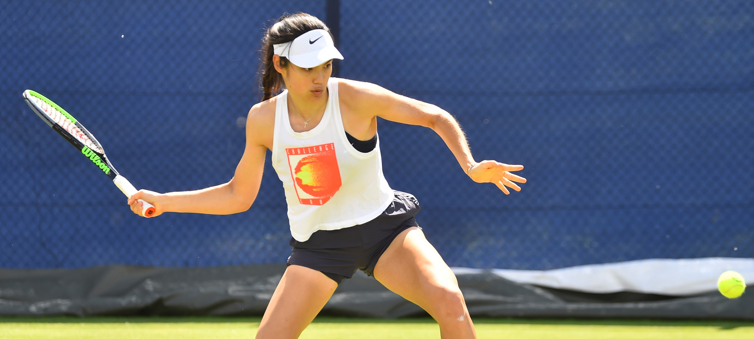
A2: SKILLS AND TECHNIQUES REQUIRED
TO PERFORM IN tennis
b1: TECHNICAL DEMANDS REQUIRED
TO PERFORM IN TENNIS
You need to know the
specific skills required for tennis, and the applied technique of
the skills for effective participation.
Continuous skills
Serial skills
Discrete skills
Attacking and
defensive skills
What are attacking shots and defensive shots in tennis?
Identify and breakdown
how tennis techniques and skills are applied for
effective participation.
Notes:
2019: A2 Skills and techniques required to perform in sport
AND
2016: B1 Technical demands required to perform in tennis

Slide 10
A3&B2: Tactical DEMANDS applied IN TENNIS
Tactical demands applied in tennis performance
Defending and attacking
Decision making
Communication
Environmental conditions
Make a list of tennis tactics you
have used or seen other tennis players use.
Identify which of the above headings each tactic comes under.
Notes:
2019: A3 Tactical demands applied in Tennis
AND
2016: B2 Tactical demands applied in Tennis

Slide 11
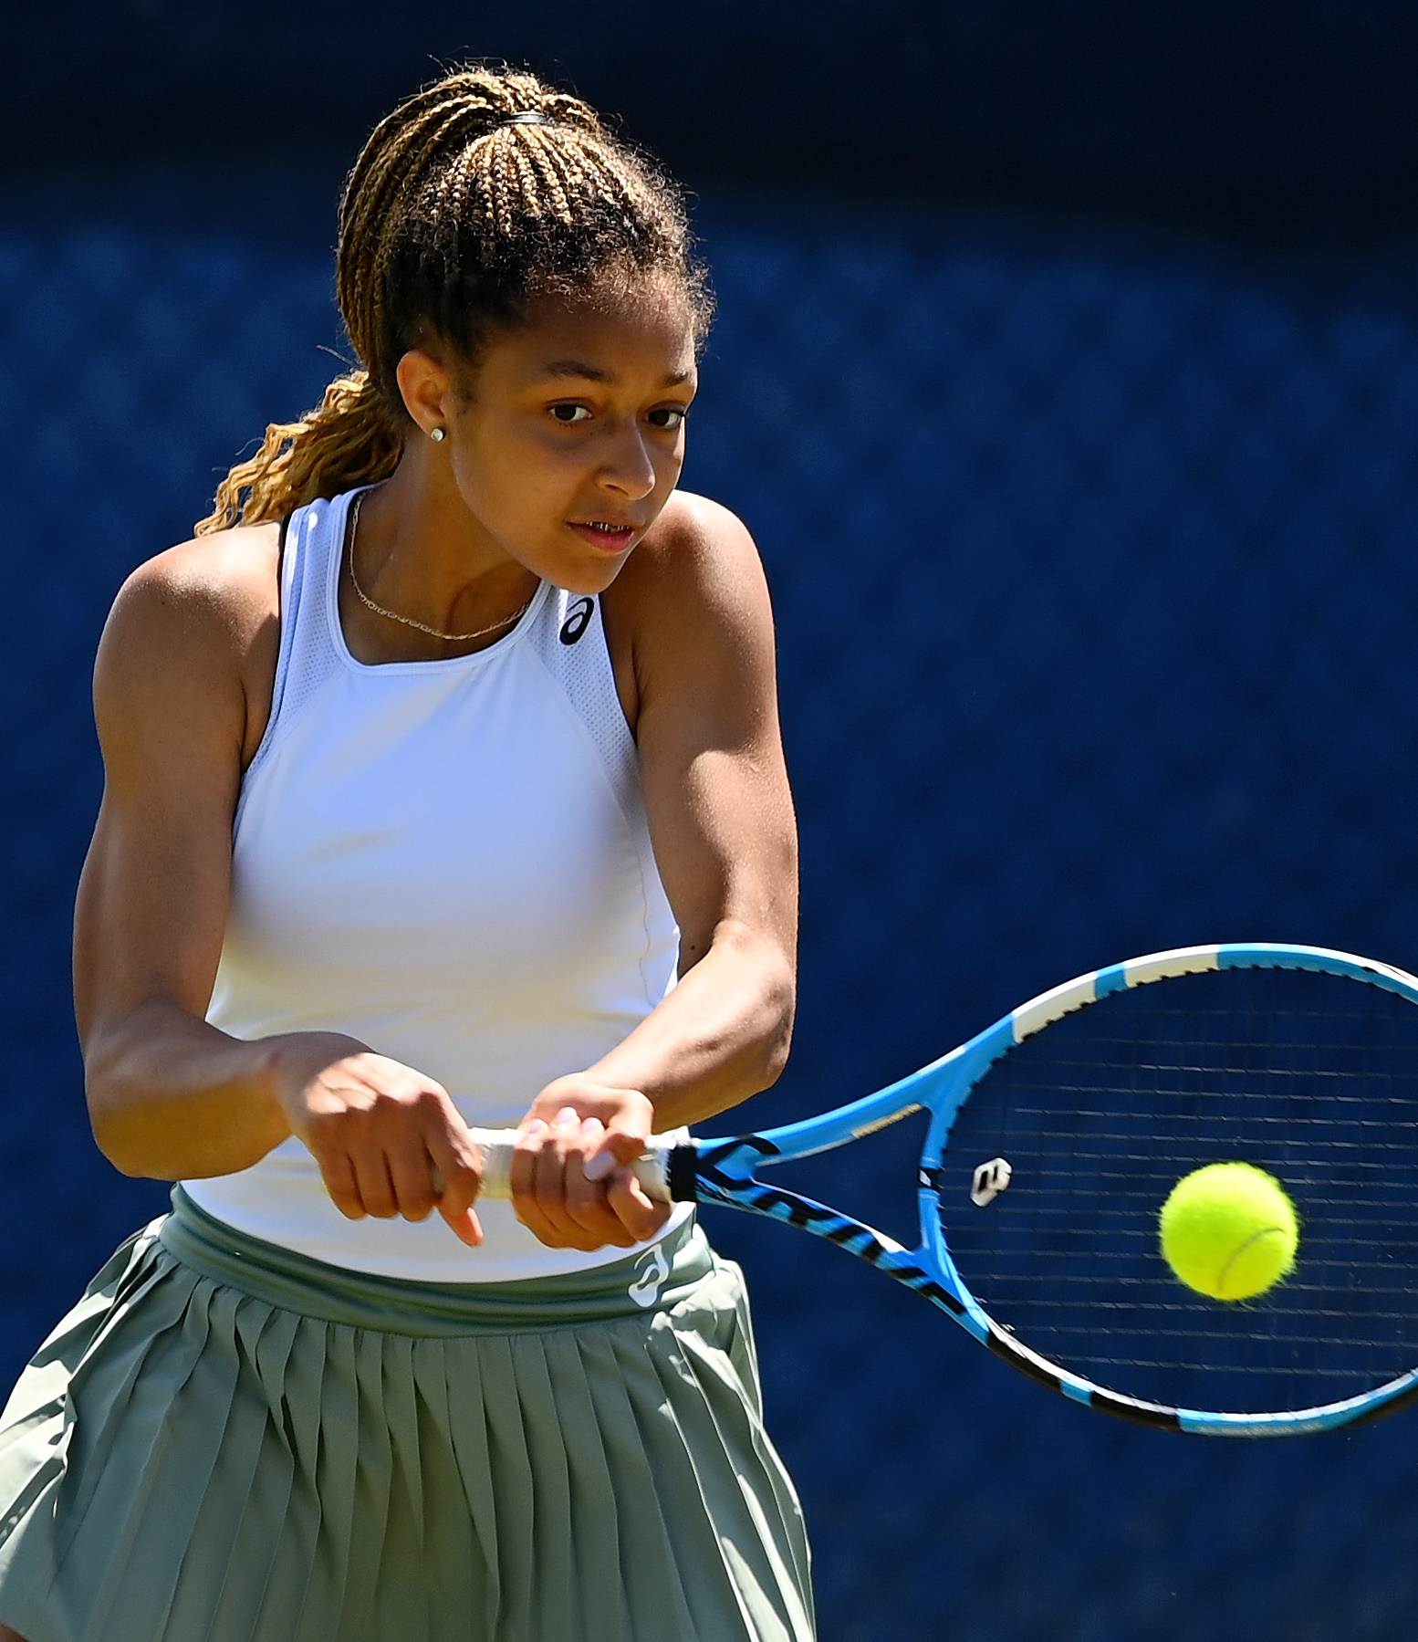
B1&C1: Safe and appropriate practical performance demonstration and participation
Demonstrate tennis skills, techniques and tactics
in a controlled environment.
Demonstrate isolated practices, conditioned practices and competitive situations:
  Isolated practices: skills and techniques demonstrated independently without any pressure or external forces
  Conditioned practices: conditioned point play
  with added rules
  Competitive situations: under NGB rules/laws
  with match officials and appropriate opposition
Demonstrate the application of rules and regulations and show effective use of skills, techniques and the correct application of each component.
Notes:
2019: Safe and appropriate practical performance demonstration and participation
AND
2016: Safe and appropriate practical performance demonstration and participation

Slide 12
c1&D1:
ASSESSMENT METHODS TO REVIEW THE PERFORMANCE
of skills, TECHNIQUES AND TACTICS IN TENNIS
Which assessment methods can be used to review the skills and techniques performed and the use of tactics in tennis?
SWOT analysis
Observations
Performance
profiling
Testing
Interviews
Objective
performance data
Use of
technology
Notes:
2019: C1 Assessment methods to review the performance of the skills, techniques and tactics in tennis
AND
2016: D1 Assessment methods to review the performance of the skills, techniques and tactics in tennis

Slide 13
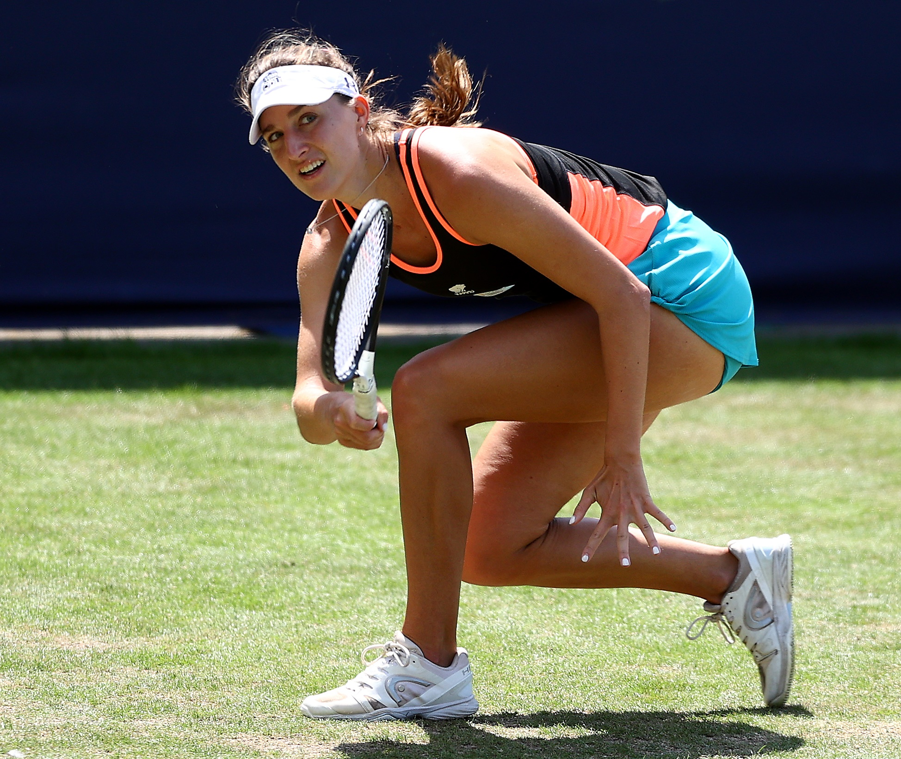
c2&D2:
reviewing performance
in tennis
Decide what to assess:
  Skills and techniques
  Use of tactics
  Application of the rules
  Effectiveness of decision making
Select assessment methods
Review performance identifying strengths and areas for improvement
Notes:
2019: C2 Reviewing performance in tennis
AND
2016: D2 Review performance in tennis

Slide 14
c3&D3:
Developments to improve performance
Following the review, how would you improve your tennis performance?
Identify aims
and objectives
Short and long
term goals
SMART targets
(specific, measurable, achievable,
realistic, timebound)
Identify opportunities
e.g. training programmes
Qualifications
Notes:
2019: C3 Developments to improve performance
AND
2016: D3 Developments to improve performance

